Slide 1
Finding the policies we already won: a silent loss in the issuance funnel
Eric Riley

Slide 2
We know where customers leave the sales funnel. We don't know which losses matter.
Goal: Grow the number of policies we issue from the customers we already attract.
What we see: The biggest drop is after the quote. Both IT and P&C flag it, and the usual explanation is price shopping.
What we don't see: 791 customers completed an application and never received a policy. By every current measure it's the smallest loss on the chart, so no one has asked why.
What we don't know: Which of these losses are normal and which aren't. Our reports count how many people leave at each step. They don't tell us whether leaving at that step should be expected.
So what: Every customer who completes an application represents cost already spent: marketing, quoting, underwriting. Without knowing which losses are avoidable, we can't tell whether the answer is more shoppers or a better process.
Digital Store Front
Quote Start
Quote Complete
Application Start
Application Complete
Issuance
9,793 (100%)
8,560 (87%)
7,287 (74%)
Biggest drop: after the quote. IT: lowest pass rate. P&C: largest loss.
5,883 (60%)
4,907 (50%)
4,116 (42%)
791 completed applications never got a policy: 1 in 6

Slide 3
The pizza that never came
Problem: You order a pizza online. The site confirms it. The pizza never comes, and you order somewhere else.
The business sees two identical groups.
Only the customer knows the order was never delivered.
Group 1:
Fill out order (Digital Device)
Place order
Get order confirmation
Get Pizza
Group 2:
Fill out order (Digital Device)
Place order
Get order confirmation
No Pizza
Order Somewhere else
The business's view ends here.
The pizza place sees a slightly slow night. No complaint, no refund, no missing payment. Just fewer pizzas than they expected, and no idea why.
How each team explains the slow night
The owner (P&C): "Sales are down. Fewer pizzas than we expected.“
The website team (IT): "Every order went through. Our system shows success.“
Marketing: "We need more people to see our ads.“
Everyone is right about their own numbers. No one on the business side knows the pizza never came.
Takeaway: No charge, no complaint, no record. A loss nobody can see is a loss nobody fixes.

Slide 4
Everyone is ‘right’, so no one changes
Each team's numbers are right, so each team looks to the others for the answer. Meanwhile, the loss no one can see keeps happening. No one acts, and revenue doesn't move.
“Check your system”
P&C
“System meets acceptance criteria”
IT
“Bring in more traffic”
The Loss
No one sees
“Traffic quality is not our problem”
“Fix your pricing”
Marketing
No one is wrong, and nothing changes. To break the stalemate, we have to look inside the funnel.

Slide 5
It turns out we weren't measuring where the loss happens.
Trap: an application that hits a system error during processing
Digital Store Front
Quote Start
Quote Complete
Application Start
Application Complete
Issuance
Up to application complete, applications with and without a trap look the same.
 | No trap | Trap | p
IT trap | 83.2% | 84.3% | 0.36
At issuance, applications with a trap fall 16 points behind, and no one flags it here.
 | No trap | Trap | p
IT trap | 87.4% | 71.5% | 1.8×10⁻³⁵
87%
72%
87% issued, clean path
72% issued after a trap
170 more lost than the clean path predicts

Slide 6
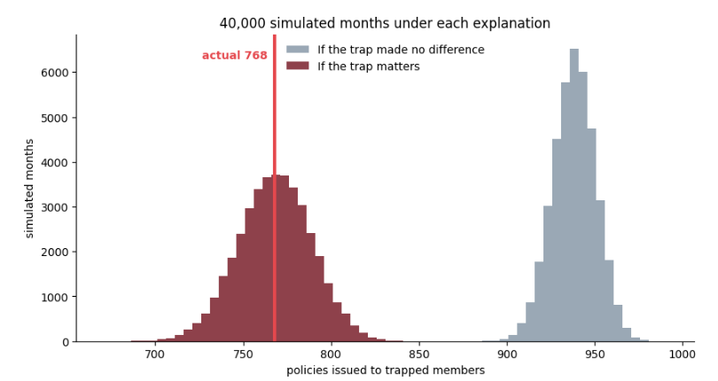
"No difference" can't produce 768. The trap explains it.
IT is concerned about dedicating resources to a problem that is not proven. That's reasonable, so we tested it directly.
If the trap made no difference, we'd expect about 935 policies. We got 768, a gap of about 170.
None of 40,000 simulated months came close. When trapped applications issue at their own rate, the simulation lands right on 768.
Takeaway: The trap is real. Next, we show exactly where it leaks, so IT knows where to look.

Slide 7
The funnel works as designed, except for one unexpected path.
IT says the loss is expected; P&C says it isn't. Measured against the system's own clean path, the business-rule loss is expected, but the IT trap's is not.
As designed: each stage depends only on the one before it.
IT
STORE
QSTRT
QCOMPL
ASTRT
ACOMPL
ISSUE
Rule
What the data shows: two paths skip every stage and go straight to issuance.
The IT trap. That loss is not expected.
IT
No stage shows it. Trapped and untrapped applications look the same at every stage until issuance. Then trapped ones issue about 16 points less. That difference is the whole finding.
STORE
QSTRT
QCOMPL
ASTRT
ACOMPL
ISSUE
Rule
Some applicants don't qualify. That loss is expected.
Takeaway: Every stage works as designed. One loss is expected; the IT trap is not, and that's where IT should look.
Notes:
Being labeled trapped guarantees you advanced far enough to be trapped. That guaranteed advancement is what makes trapped members look like better prospects.

Slide 8
Summary: One path, about 170 policies a month, one place to look
The question: Are sales slow, or is something in the process losing customers we already won?
Why it stayed hidden: P&C, IT and Marketing each measure correctly, and they agree where most customers leave. But no one flags the last step, from completed application to issued policy.
What we found: Trapped applications look normal at every stage until issuance, then issue about 16 points less. If the trap made no difference, none of 40,000 simulated months comes close to what we actually see.
Where it is: The funnel works as designed except for one unexpected path, from the trap straight to issuance. Underwriting denials are a second path, but that loss is expected.
What it means: About 170 policies a month, roughly 2,000 a year. IT doesn't need to audit the whole pipeline, just one path.
Notes:
Being labeled trapped guarantees you advanced far enough to be trapped. That guaranteed advancement is what makes trapped members look like better prospects.

Slide 9
BACK UP

Slide 10
Started with the declared structure (Draw it out).
A simulation of the process as drawn and agreed upon can only produce the paths you drew. (Back to : Pizza form Receipt Order received)
There was a leak and the leak wasn't on the drawing, so the simulation was never going to find it.
4. What found it was comparing the real data against the drawing and seeing where they disagreed.
The natural assumption —a bad experience makes people give up and leave. That’s was the hypothesis, and it suggested who owns the fix.
If traps drive people away, it's a customer-experience problem. If they don't, it's something else entirely.
Simplified
Two questions, asked of both traps:
Does hitting a trap make someone less likely to finish their application?
No. Neither one. People finish at the same rate either way.
Does hitting a trap make a finished application less likely to issue?
Yes. Both. Heavily.
Why it matters that they don't cause drop-out: if people were leaving, you'd be trying to change customer behavior, which is slow and uncertain. They aren't leaving. The applications are sitting there, finished, and something at the end isn't completing them. That's a systems problem with a known population — 1,809 applications you can point at.
 | Completion rate, no trap | with trap | p
IT trap | 83.2% | 84.3% | 0.36
Business trap | 83.3% | 83.9% | 0.71
89%
72%
clean path
hit a system error
253 completed applications that never became policies.
 | Issuance, no trap | with trap | p
IT trap | 87.4% | 71.5% | 1.8×10⁻³⁵
Business trap | 85.3% | 75.9% | 2.8×10⁻¹⁰

Slide 11
PPC explained simply
Free throws
Step 1 — What do we know before?
Nothing. Never seen this kid shoot. Could be terrible, could be great. Uninformative prior
Step 2 — Watch her shoot.
She takes 100 shots. Makes 87. Likelihood
Step 3 — Now what do we think?
She's probably around an 87% shooter. Not exactly — maybe 85, maybe 89. We're not going to pin it down perfectly from 100 shots.
That range is what we believe about her.
Step 4 — Now predict.
She's going to take 100 more shots tomorrow. How many does she make?
Not exactly 87. Two things move it around:
So the honest answer is: probably somewhere around 87, give or take 4. Say 83 to 91.
That's what we believe about the next hundred shots.
Step 5 — Watch her shoot again.
She makes 62.
The point
62 isn't in the range. Not close to it.
We didn't say, "she'll make exactly 87." We gave her every benefit of the doubt — she might be worse than we thought, and she might have an off day. We accounted for both.
62 is still too far. Something changed that we don't know about. Different gym, injured wrist, something.

Slide 12
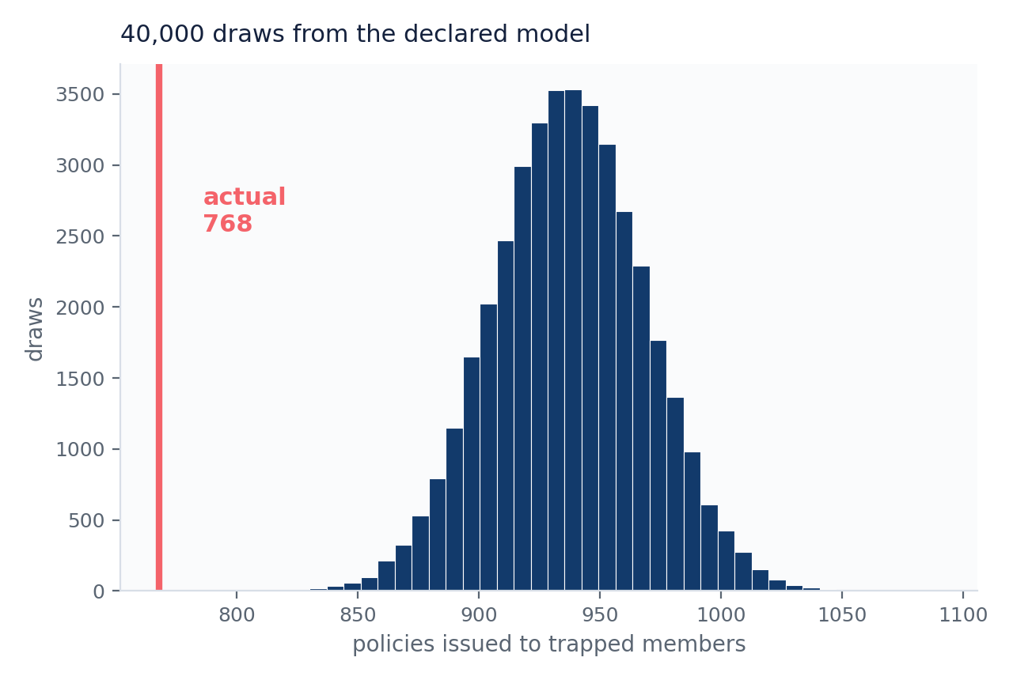

I ran what IT believed 40,000 times. It never produced what happened.
“Their assumption predicts 937. Reality is 768. The assumption is the only thing I borrowed — so the gap is theirs.”
Check | Observed | Predicted | Z
Storefront | 2,104 | 2,103 ± 10 | +0.05
Quote start | 1,876 | 1,875 ± 22 | +0.05
Quote complete | 1,597 | 1,596 ± 29 | +0.05
Application start | 1,274 | 1,273 ± 32 | +0.04
Application complete | 1,074 | 1,073 ± 33 | +0.03
POLICIES ISSUED | 768 | 937 ± 31 | −5.41
Draw it out
Path 1: Trapped Flow
Hit IT Error
Complete App.
Issuance
(71%)
IT only looks here and assumes the two states are identical
This delta (-16pp) is γ
Path 2: Clean Flow
No IT Error
Complete App.
Issuance (87%)
What IT's chain requires: Trap is independent of Issuance, given App Complete.
Trap $⊥⊥$ Issuance | App Complete. This says that once I know App Complete, Trap and Issuance are independent.
The finding is that it fails:
Trap $⊥⊥$ Issuance | App Complete
I took the trap out and ran what they believed 50,000 times. The closest it ever came was 809. Reality was 768. Their model can't produce what actually happened.
0
809
Conditioning: Same funnel position, split by error. The funnel can't explain the gap because I already removed it.
of 40,000 draws reached 768
lowest the model ever produced
Key takeaway:
There’s a connection left after accounting for everything else in the model. The funnel variables don't explain it away.
And the localization: conditioning on a completed application, Q[Trap, Issued] = +1.21 where a chain requires zero. Partial correlation. The defect is the edge, not the coefficients. No combination of settings and luck ever got there. Not once in 50,000 tries. So it's not bad luck. Something about the gates is wrong.
5
Notes:
SAY: "I took what IT believed, wrote it down as a model, and ran it forty thousand times. It never once produced what actually happened."
THE WHOLE THING, PLAINLY:
IT said — yeah, some people hit errors and drop out along the way, but the ones who fill out the whole application are fine.
So take the 2,157 people who hit an error. Walk them through the funnel using THEIR OWN drop-off rates at every stage — so of course those match, you're using their numbers.
At the very last step, swap in the clean members' rate: 87.4% of completed applications become policies. That's IT's claim, word for word. If they're right, trapped members behave the same at that step.
Run it 40,000 times. It predicts 937 policies. Reality is 768. Not once in 40,000 runs did it get as low as 768 — the worst it ever managed was 809, and reality is worse than that.
So IT's sentence isn't slightly off. It can't produce what actually happened.
THE ONE-LINER FOR THE GAP: "Their assumption predicts 937. Reality is 768. The assumption is the only thing I borrowed, so the gap is theirs." Everything else in that model came from the trapped members' own behavior — the 87.4% is the single borrowed number and the only thing that can be wrong.
WHY THIS IS A REAL TEST: everything except that last number came from the trapped members themselves. The 768 is the one thing the model never saw. That's what makes it a test instead of a mirror.
NUMBERS: predicted 937 +/- 31, observed 768, Z = -5.41. Zero of 40,000 draws reached 768.
LOCALIZATION — THREE LEVELS. Only go down one when they ask.
LEVEL 1, say this: "So I checked every connection in the model, one at a time, holding everything else fixed. Only one came back with something in it — the link between hitting an error and not buying. Under IT's version that link isn't supposed to exist at all."
LEVEL 2, if they ask how: "There's a standard calculation for it — precision matrix. It's a way to test every connection at once instead of guessing which one to look at."
LEVEL 3, only if they're technical and push: "It's the inverse of the covariance matrix. Zeros in it are conditional independence, so a nonzero where the model says zero is a missing link." Numbers: Q[Trap, Issued] = +1.21 where a chain requires zero, partial correlation -0.178, Fisher z = -12.6 on 4,907 records.
THE PLAIN WAY TO SHOW IT: "Take only the people who filled out the entire application — everyone at the same point, one step from buying. If IT were right, hitting an error shouldn't matter anymore. It matters a lot: 71% of the error group buys, 87% of the clean group. Something is still happening at signature that nobody had drawn."
WHERE THE MISSING EDGE IS: a direct link from error to not-buying that doesn't run through any funnel stage. IT drew error > stages > application complete > bought. The data has that PLUS an arrow reaching all the way to the buy button.
WHAT THE ARROW ACTUALLY IS — don't overclaim: could be the error hits at checkout, could be it happened earlier and eroded trust, could be errors just fire on unusual cases that were never going to close. Separating those needs error timestamps against stage timestamps. That's the data request I'd walk out with.
IF THEY SAY "isn't this just comparing two percentages?" — "It is. What the model adds is showing that every stage is clean and only the last step breaks, so you know exactly where the problem is, not just that one exists."
THIS RUNS ON REAL DATA. No synthetic anything.

Slide 13
The leak is invisible in a correlation matrix The correlation matrix makes it look like nothing
Correlation Matrix
00000
Declared Structure
IT
STORE
QSTRT
QCMPL
ASTRT
ACMPL
RULE
ISSUE
1.00
-.014
0.021
.014
.002
.008
-.007
-.059
IT
IT
-.014
1.00
.354
.238
.174
.143
.055
.122
STORE
QSTRT
QCOMPL
ASTRT
ACOMPL
ISSUE
STORE
Rule
QSTRT
.021
.354
1.00
0.672
.490
.403
-.008
.343
Adjacent gates correlate strongly — .354, .672, .729, .821, .852.
Non-adjacent pairs match the chain exactly. STORE to ISSUE: .354 × .672 × .729 × .821 × .852 = .122. Observed .122.
STORE to ISSUE = 0.122
IT to STORE = -0.014
IT to ISSUE should be −.014 × .122 ≈ −.002. It's −.059. Thirty times too large — and the smallest number in the column.
Observed IT–ISSUE: −.059.
Observed does not match the path
.014
.238
.672
1.00
.729
.599
-.013
.510
QCMPL
.002
.174
.490
.729
1.00
.821
-012
.700
ASTRT
ACMPL
.008
.143
.403
.599
.821
1.00
-.007
.852
-.007
.005
-.008
-.013
-.012
-0.007
1.00
-.039
RULE
-.059
.122
.343
.510
.700
.852
-0.039
1.00
ISSUE
Notes:
The last row is the one to volunteer. Q[IT, app complete] gives +0.093 at z = +9.36 — trapped members are MORE likely to reach app complete. That is immortal time bias, because the exposure flag has no gate index. It does not break the terminal result, since that comparison already conditions on reaching app complete. Name it before someone inverts your matrix and finds it.

Slide 14

The leak is visible in the precision matrix
Precision Matrix
IT
STORE
QSTRT
QCMPL
ASTRT
ACMPL
RULE
ISSUE
Interpretation of the off diagonals
The band is the declared structure. −0.406, −1.226, −1.559, −2.529, −3.178 run down the off-diagonal — each gate connects only to the one before it. Everything two steps apart is zero, which is what a chain looks like in a precision matrix.
The red cells are not in the declared structure. Q[IT, ISSUE] = +0.246 and Q[RULE, ISSUE] = +0.125 connect an exposure directly to the outcome, bypassing all five gates. Partial r = −0.126 at z = −12.68, and −0.065 at z = −6.46.
Sign convention: partial r =$\frac{\text{−Qij}}{\sqrt{\text{Qii }∙ \text{Qjj}}}$ ,so, a positive Q entry means a negative partial correlation. +0.246 means trapped members issue less.
1.017
0.246
IT
1.144
-0.406
STORE
QSTRT
-0.406
1.969
-1.226
QCMPL
-1.226
2.961
-1.559
Declared Structure
IT
ASTRT
-1.559
4.208
-2.529
STORE
QSTRT
QCOMPL
ASTRT
ACOMPL
ISSUE
Rule
ACMPL
-2.529
5.783
-0.114
-3.178
Effect not explained by any gate. Q = +0.246 Partial(AVP) -0.126 z = -12.68
-0.114
1.005
0.125
IT
Artifact Q = -0.227 Partial 0.093 Immortal Time
RULE
Being labeled trapped guarantees you advanced far enough to be trapped. That guaranteed advancement is what makes trapped members look like better prospects.
STORE
QSTRT
QCOMPL
ASTRT
ACOMPL
ISSUE
0.246
-3.178
0.125
3.724
The funnel's own structure checks out — each stage connects to the next exactly as the process says, all the way down. What doesn't check out is the IT trap. Its effect shows up at issuance, and no stage in between accounts for it.
ISSUE
Rule
Effect not explained by any gate Q = +0.125 Partial (AVP) -0.065 z = -6.46
No gate shows it. Compare members who took identical paths through all five gates, and the trapped ones still issue less. That difference is the whole finding.
One thing I checked: you can only be flagged as trapped at a gate you reached. So, the trapped group is enriched for people who got deep in the funnel — that's the +0.093 partial at ACMPL, and it's an artifact, not a finding. The fix is comparing members standing at the same gate, split by whether they were trapped there.
This structure asserts Q[IT, ISSUE] = 0 and Q[RULE, ISSUE] = 0. Every arrow not drawn is a testable claim.
Notes:
The last row is the one to volunteer. Q[IT, app complete] gives +0.093 at z = +9.36 — trapped members are MORE likely to reach app complete. That is immortal time bias, because the exposure flag has no gate index. It does not break the terminal result, since that comparison already conditions on reaching app complete. Name it before someone inverts your matrix and finds it.

Slide 15

IT measures performance. P&C measures loss
IT: how well does each stage perform, given who reached it? P&C: where did the book get lost, as a share of the whole?
Quote Complete → App Start: 5,883 / 7,287 = 80.7% (Worst Transition) vs. Quote Complete $→$ App Start: 1404/ 9,793 = 14.3% (Largest Loss)
Survival from Store Front to Issuance is 42.0%. Every additional policy costs roughly 2.4 more arrivals at the top — and top-of-funnel volume is not something you can decide to have.
9,793
Quote Complete
7,287
4,907
4,116
Notes:
ARC: they agree on the location, disagree on the meaning, and the only lever anyone can name is volume.
Do NOT say IT thought the transition was fine — their own number flags it as their worst. Say: IT saw a stage performing normally for who reached it; P&C saw the book bleeding.
THE ARITHMETIC, if pushed:
Survival to Issuance = 4,116 / 9,793 = 42.0%. 1 / 0.420 = 2.4 arrivals per policy.
245 / 0.4203 = 583 arrivals. Round to 580 when speaking.
Survival to Application Complete = 4,907 / 9,793 = 50.1% (2.0 arrivals each) — use only if asked about that stage.
The 245 is a 5 percentage point (absolute) yield gain at App Complete → Issuance, p5 = 0.8388.
LEVERAGE, if she asks which stage to improve: 5 points at Quote Complete → App Start yields 255 policies, the highest of the five. Worst rate, largest loss, and highest leverage all land on the same transition.
This slide sets up the 253. Leave them holding an expensive, uncertain answer before showing the leak.

Slide 16
The four numbers a complete review reports
Every accept/reject decision can go wrong in two ways, and each has a classical version and a Bayesian version:
The left column is what the count test already gives you, however the breach limit is set. The right column is what's missing, and it's what the person signing off actually decides on. In quality terms, it's consumer's risk and producer's risk seen from after the decision rather than before it.
A picture of all four at once
Take 1,000 models, 30% of them running at double their stated risk, and apply the same 4-breach rule:
1,000 models
700 good (1% rate)
624 pass
76 fail ← false alarms
300 bad (2% rate)
132 pass ← misses
168 fail
Passed: 624 + 132 = 756 → P(bad | pass) = 132/756 = 17%
Failed: 76 + 168 = 244 → P(good | fail) = 76/244 = 31%
Both sides show up at once. About 1 in 6 accepted models is actually bad, and nearly 1 in 3 flagged models is actually fine. The second number matters too: a false alarm costs real money in unnecessary investigation or remediation, so this isn't only an argument for being stricter.
The formulas behind the two right-column numbers:
P(bad | pass) = P(pass | bad)·π / [P(pass | bad)·π + P(pass | good)·(1 − π)]
P(good | fail) = P(fail | good)·(1 − π) / [P(fail | good)·(1 − π) + P(fail | bad)·π]
where π is the prior probability, the model is bad, taken from its record.
How the breach count fits in
The count stays the primary evidence no matter how a company sets its limit. The Bayesian layer just uses it more fully: instead of pass/fail, it updates on the actual count k each day, p | record, k breaches in n days ~ Beta(α + k, β + n − k) and reports P(p > tolerance) as a running number, like the 3% → 36% table from the previous step.
The 1,000-model tree is the fastest way to show the idea, because it needs no statistical terms, and it shows you're weighing both kinds of error rather than just arguing for a stricter test.
 | Classical (fact about the test) | Bayesian (fact about the model in production)
Miss a bad model | P(pass | bad) | P(bad | pass)
False alarm on a good model | P(fail | good) | P(good | fail)

Slide 17












We know where customers leave the sales funnel. We don't know which losses matter.
What we see: The biggest drop is after the quote. Both IT and P&C flag it, and the usual explanation is price shopping.
What we don't see: 791 customers completed an application and never received a policy. By every current measure it's the smallest loss on the chart, so no one has asked why.
What we don't know: Which of these losses are normal and which aren't. Our reports count how many people leave at each step. They don't tell us whether leaving at that step should be expected.
So, what: Every customer who completes an application represents cost already spent: marketing, quoting, underwriting. Without knowing which losses are avoidable, we can't tell whether the answer is more shoppers or a better process.
$${P\&C= s}_{j}=\frac{{n_{j}−n}_{j+1}}{n_{0}}$$
$${IT= r}_{j}=\frac{n_{j+1}}{n_{j}}$$
Contrived Example using easy to understand integers
Digital Store Front
N₁= 10,000
Quote Start
IT = $\frac{9,000 }{10,000}=90\%$Transistion
P&C = $\frac{10000 −9000}{10,000}$ = 10% Loss
N₂= 9,000
N₃ = 5,000
P&C = $\frac{9000 −5000}{10,000}$ = 40% Loss
Lowest Transition, Highest Loss
Quote Complete
IT = $\frac{5,000 }{9,000}=56\%$Transistion
IT = $\frac{4,000 }{5,000}=80\%$Transistion
P&C = $\frac{5000−4000}{10,000}$ = 10% Loss
N₄=4,000
App Start
IT = $\frac{3,000 }{4,000}=75\%$Transistion
P&C = $\frac{4000−3000}{10,000}$ = 10% Loss
N₅=3,000
App Complete
Issuance
IT = $\frac{2,000 }{3,000}=67\%$Transistion
P&C = $\frac{3000−2000}{10,000}$ = 10% Loss
N₆=2,000
100% - 67% = 33% 1 in 3 who completed an application never got a policy. Neither measure flags it.
Notes:
Beat: the failure happens after the order is placed and leaves no record. Do not say the error causes drop-off during the journey - the data shows the two arms are identical at all five upstream gates. Open question to close before presenting: when do the traps fire? If most fire near Application Complete, upstream parity is true by construction.

Slide 18
We know where customers leave the sales funnel. We don't know which losses matter.
Goal: Grow the number of policies we issue from the customers we already attract.
What we see: The biggest drop is after the quote. Both IT and P&C flag it, and the usual explanation is price shopping.
What we don't see: 791 customers completed an application and never received a policy. By every current measure it's the smallest loss on the chart, so no one has asked why.
What we don't know: Which of these losses are normal and which aren't. Our reports count how many people leave at each step. They don't tell us whether leaving at that step should be expected.
So what: Every customer who completes an application represents cost already spent: marketing, quoting, underwriting. Without knowing which losses are avoidable, we can't tell whether the answer is more shoppers or a better process.
Digital Store Front
Quote Start
Quote Complete
Application Start
Application Complete
Issuance
9,793 (100%)
8,560 (87%)
7,287 (74%)
Biggest drop: after the quote. IT: lowest pass rate. P&C: largest loss.
5,883 (60%)
4,907 (50%)
4,116 (42%)
1 in 6 lost after applying. No one flags it.
Notes:
Beat: the failure happens after the order is placed and leaves no record. Do not say the error causes drop-off during the journey - the data shows the two arms are identical at all five upstream gates. Open question to close before presenting: when do the traps fire? If most fire near Application Complete, upstream parity is true by construction.

Slide 19
The pizza that never came
Assumption: We're counting orders that work the first time.
Problem: You order a pizza online. The site confirms it. The pizza never comes, and you order somewhere else.
The Business Sees:
The Customer Experience:
Group 1:
Fill out order (Digital Device)
Place order
Get order confirmation
Get Pizza
Group 2:
Fill out order (Digital Device)
Place order
Get order confirmation
No Pizza
Order Somewhere else
The business's view ends here.
The pizza place sees a slightly slow night. No complaint, no refund, no missing payment. Just fewer pizzas than they expected, and no idea why.
How each team explains the slow night
The owner (P&C): "Sales are down. Fewer pizzas than we expected.“
The website team (IT): "Every order went through. Our system shows success.“
Marketing: "We need more people to see our ads.“
Everyone is right about their own numbers. No one on the business side knows the pizza never came.
Takeaway: No charge, no complaint, no record. A loss nobody can see is a loss nobody fixes.
Notes:
Beat: the failure happens after the order is placed and leaves no record. Do not say the error causes drop-off during the journey - the data shows the two arms are identical at all five upstream gates. Open question to close before presenting: when do the traps fire? If most fire near Application Complete, upstream parity is true by construction.

Slide 20
The pizza that never came
Assumption: We're counting orders that work the first time.
Problem: You order a pizza online. The site confirms it. The pizza never comes, and you order somewhere else.
The Business Sees:
The Customer Experience:
Group 1:
Fill out order (Digital Device)
Place order
Get order confirmation
Get Pizza
Group 2:
Fill out order (Digital Device)
Place order
Get order confirmation
No Pizza
Order Somewhere else
The business's view ends here.
The pizza place sees a slightly slow night. No complaint, no refund, no missing payment. Just fewer pizzas than they expected, and no idea why.
How each team explains the slow night
The owner (P&C): "Sales are down. Fewer pizzas than we expected.“
The website team (IT): "Every order went through. Our system shows success.“
Marketing: "We need more people to see our ads.“
Everyone is right about their own numbers. No one on the business side knows the pizza never came.
Takeaway: No charge, no complaint, no record. A loss nobody can see is a loss nobody fixes.
Notes:
Beat: the failure happens after the order is placed and leaves no record. Do not say the error causes drop-off during the journey - the data shows the two arms are identical at all five upstream gates. Open question to close before presenting: when do the traps fire? If most fire near Application Complete, upstream parity is true by construction.

Slide 21
Survival in a video game
Background: A game has four levels. To make it to level 4, you must survive levels 1,2 and 3.
Level 1
Level 2
Level 3
Level 4
100
75
55
8
50 REACH Level 4, and 8 lose
IT: Of the 50 who reached level 4, 8 lost: 8 ÷ 50 = 16%
P&C: Of all 100 who started, 8 were lost at level 4: 8 ÷ 100 = 8%
Same 8 players. P&C's number is always IT's number shrunk by the share who got that far: (50/100) × (8/50) = 8%.
Notes:
Beat: the failure happens after the order is placed and leaves no record. Do not say the error causes drop-off during the journey - the data shows the two arms are identical at all five upstream gates. Open question to close before presenting: when do the traps fire? If most fire near Application Complete, upstream parity is true by construction.

